Slide 1

Large Scale Machine Learning: SVMs
CS246: Mining Massive Datasets
Jure Leskovec, Stanford University
http://cs246.stanford.edu

Slide 2
New Topic: ML!
High dim. data
Locality sensitive hashing
Clustering
Graph data
PageRank, SimRank
Community Detection
Infinite data
Filtering data streams
Web advertising
Dimensionality reduction
Spam Detection
Queries on streams
Machine learning
SVM
Decision Trees
Perceptron, kNN
Apps
Recommender systems
Association Rules
Duplicate document detection

Slide 3
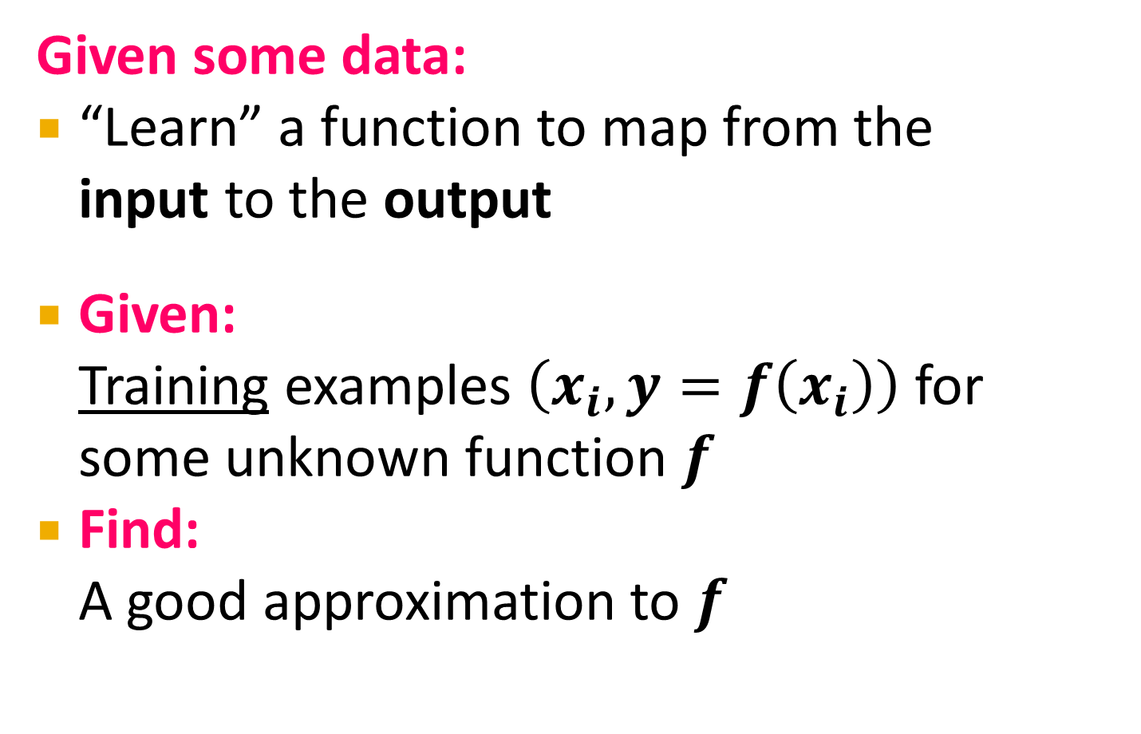
Supervised Learning
Given some data:
“Learn” a function to map from the input to the output
Given: Training examples $\left(x_{i}, y=f\left(x_{i}\right)\right)$ for some unknown function $f$
Find: A good approximation to $f$

Slide 4
Many Other ML Paradigms
Supervised:
Given “labeled data” {x,y}, learn f(x)=y
Unsupervised:
Given only “unlabeled data” {x}, learn f(x)
Semi-supervised:
Given some labeled and some unlabeled data
Active learning:
Whenever we predict f(x)=y, we then receive true y*
Transfer learning:
Learn f(x) so that it works well on new domain f(z)

Slide 5
Supervised Learning
Would like to do prediction:
estimate a function f(x) so that y = f(x)
Where y can be:
Real number: Regression
Categorical: Classification
Complex object:
Ranking of items, Parse tree, etc.
Data is labeled:
Have many pairs {(x, y)}
x … vector of binary, categorical, real valued features
y … class: {+1, -1}, or a real number

Slide 6
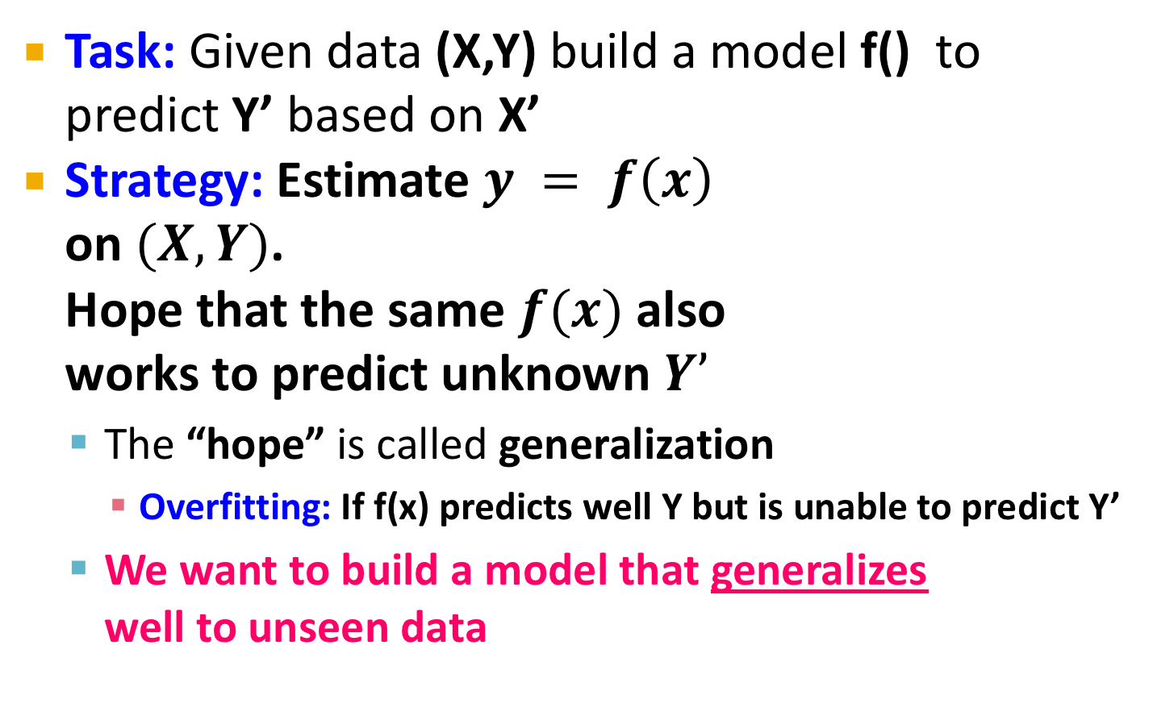
Supervised Learning
Task: Given data (X,Y) build a model f() to predict Y’ based on X’
Strategy: Estimate $y = f\left(x\right)$ on $(X,Y)$. Hope that the same $f(x)$ also works to predict unknown $Y’$
The “hope” is called generalization
Overfitting: If f(x) predicts well Y but is unable to predict Y’
We want to build a model that generalizes well to unseen data
X
Y
Training data
Test data
X’
Y’

Slide 7
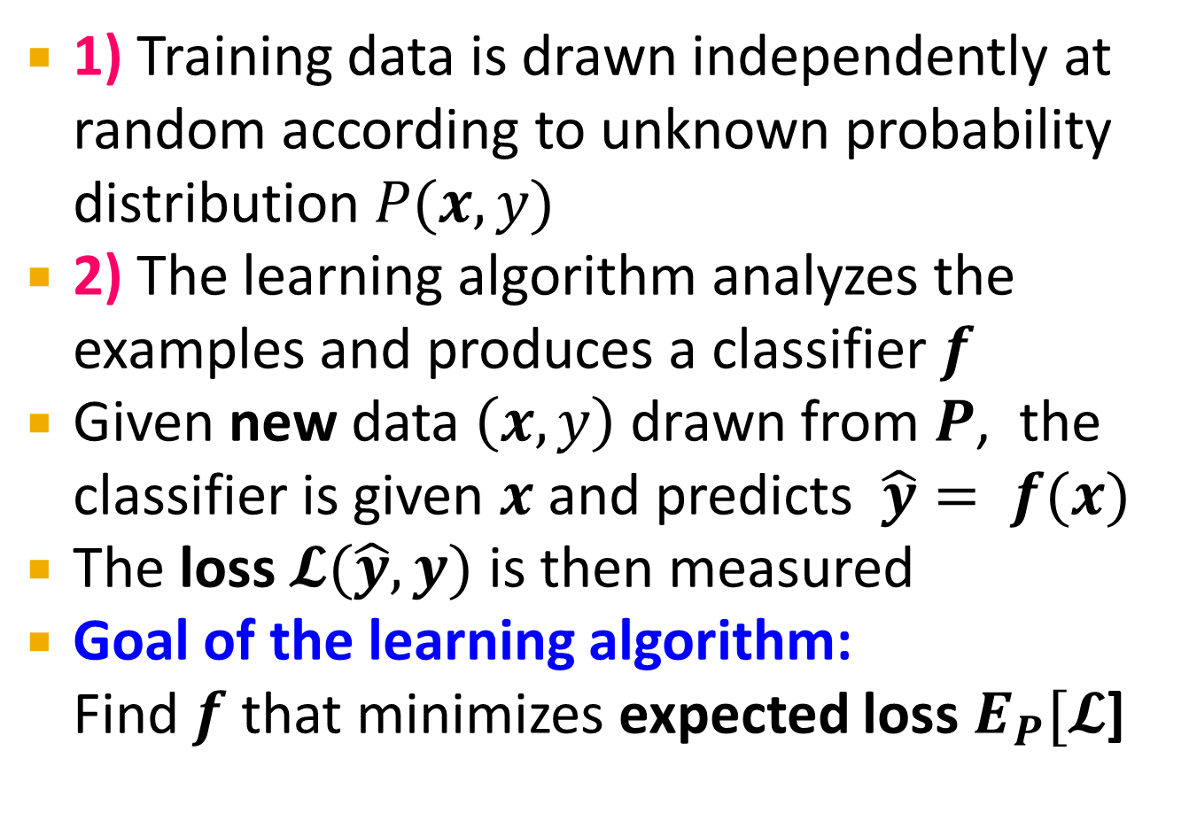
Formal Setting
training points
1) Training data is drawn independently at random according to unknown probability distribution $P(x,y)$
2) The learning algorithm analyzes the examples and produces a classifier $f$
Given new data $\left(x,y\right)$ drawn from $P$, the classifier is given $x$ and predicts $\hat{y}= f(x)$
The loss $𝓛(\hat{y},y)$ is then measured
Goal of the learning algorithm: Find $f$ that minimizes expected loss $E_{P}[𝓛$]

Slide 8





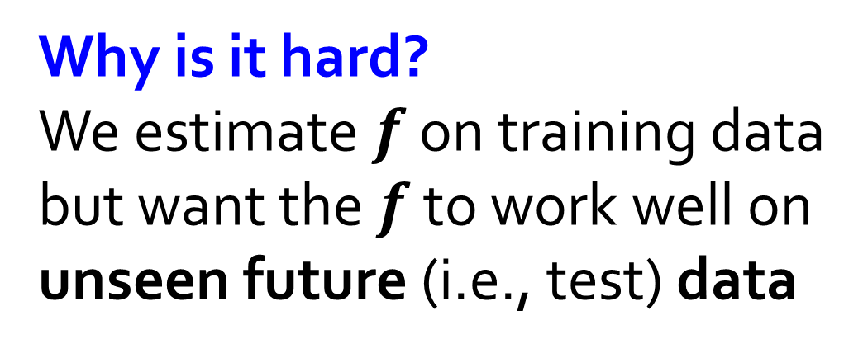


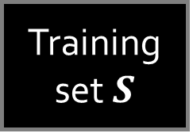

Formal Setting
test data
$$P(x,y)$$
$$(x,y)$$
training data
$$y$$
$$x$$
Training set $S$
Learning algorithm
$$f$$
$$\hat{y}$$
$$y$$
Why is it hard?
We estimate $f$ on training data but want the $f$ to work well on unseen future (i.e., test) data
loss function
$$ℒ(\hat{y},y)$$

Slide 9
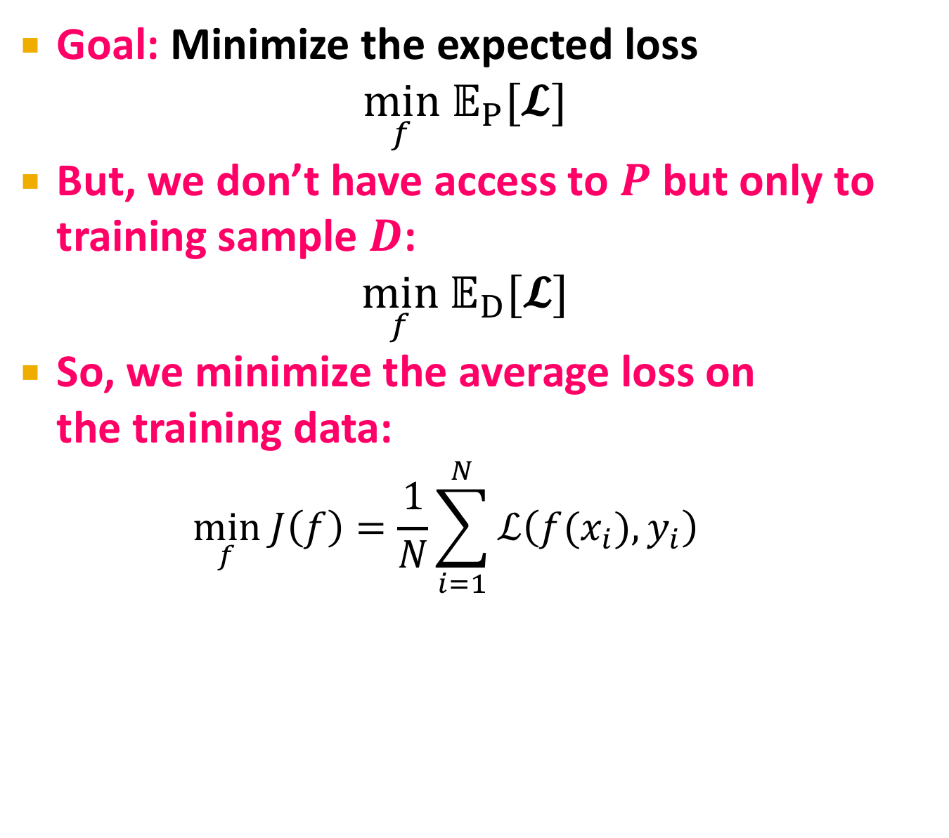
Minimizing the Loss
Goal: Minimize the expected loss
$$\min_{f} 𝔼_{P}[𝓛]$$
But, we don’t have access to $P$ but only to training sample $D$:
$$\min_{f} 𝔼_{D}[𝓛]$$
So, we minimize the average loss on the training data:
$$\min_{f} J\left(f\right)=\frac{1}{N}\sum_{i=1}^{N}{ℒ\left(f(x_{i}),y_{i}\right)}$$
Problem: Just memorizing the training data gives us a perfect model
(with zero loss)

Slide 10
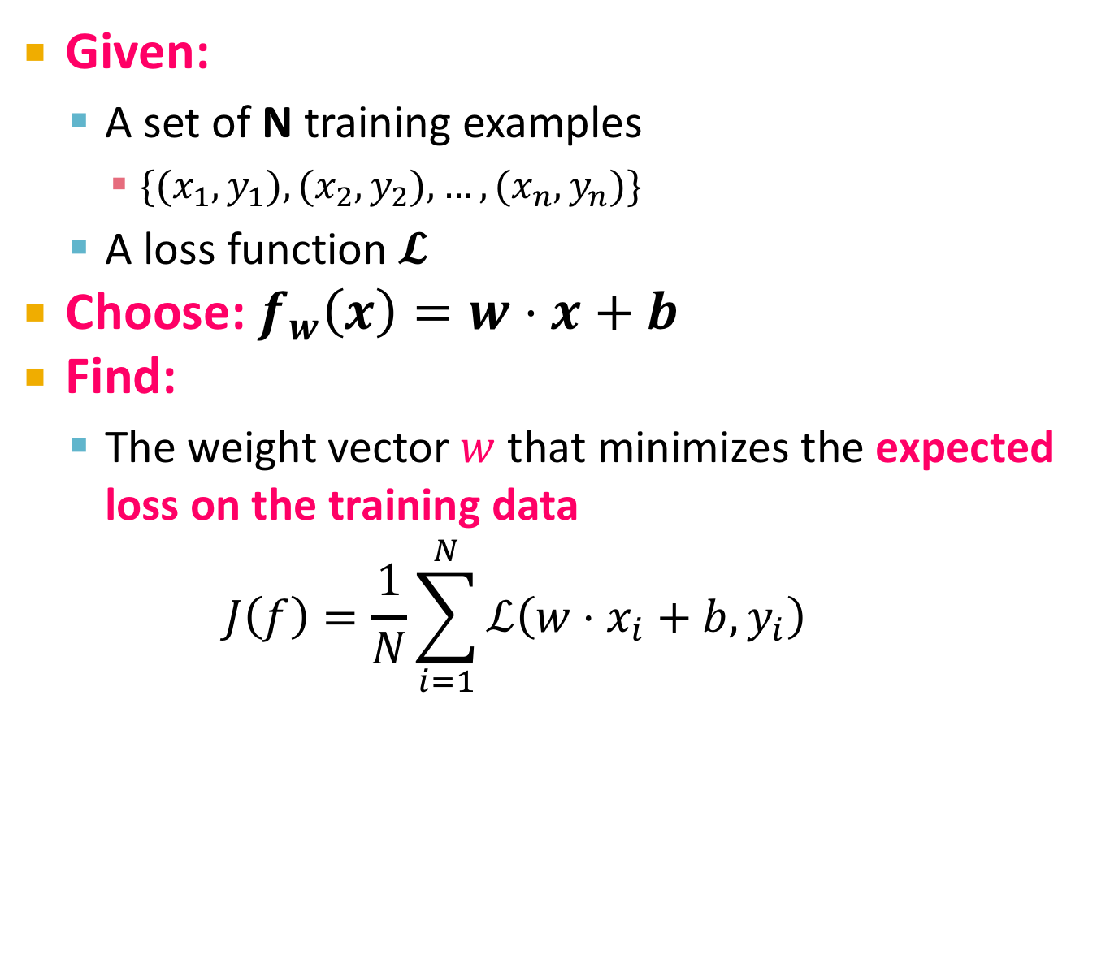
ML == Optimization
Given:
A set of N training examples
$\{(x_{1},y_{1}), (x_{2},y_{2}), …, (x_{n}, y_{n})\}$
A loss function $𝓛$
Choose: $f_{w}\left(x\right)=w⋅x+b$
Find:
The weight vector $w$ that minimizes the expected loss on the training data
$$J\left(f\right)=\frac{1}{N}\sum_{i=1}^{N}{ℒ\left(w⋅x_{i}+b,y_{i}\right)}$$

Slide 11

Problem
Problem: Step-wise Constant Loss function
Derivative is either 0 or $∞$

Slide 12
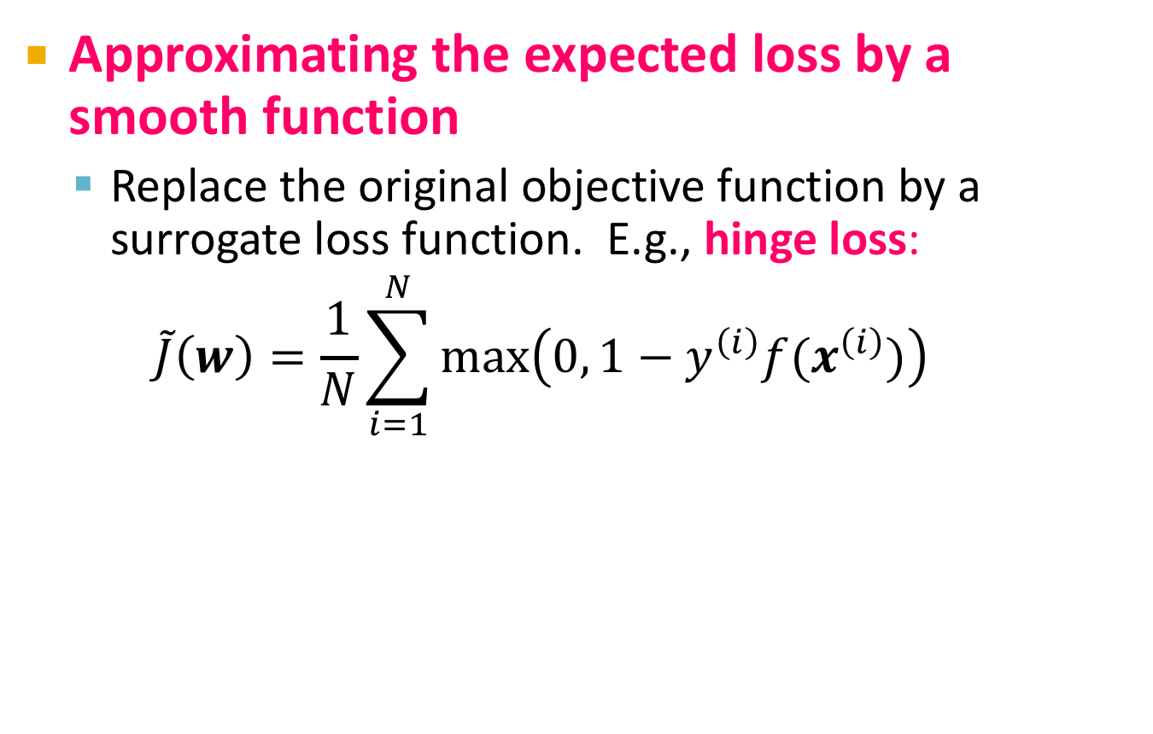
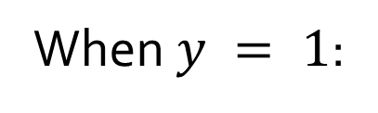
Approximating the Loss
Approximating the expected loss by a smooth function
Replace the original objective function by a surrogate loss function. E.g., hinge loss:
$$\tilde{J}\left(w\right)=\frac{1}{N}\sum_{i=1}^{N}{\max\left(0, 1−y^{\left(i\right)}f(x^{\left(i\right)})\right)}$$
When $y = 1$:

Slide 13
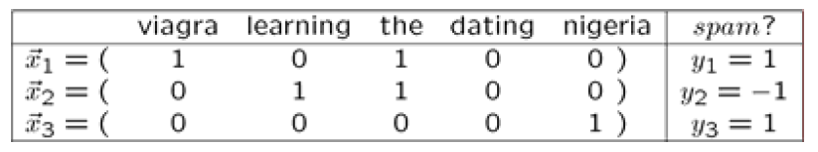
Example: Spam Detection
Example: Spam filtering
Instance space x ∈ X (|X|= n data points)
Binary or real-valued feature vector x of word occurrences
d features (words + other things, d~100,000)
Class y ∈ Y
y: Spam (+1), Ham (-1)

Slide 14
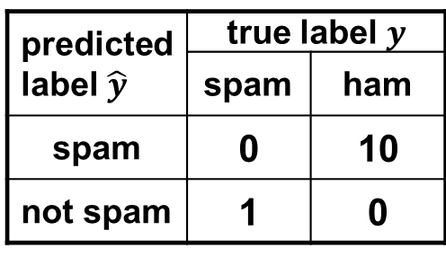
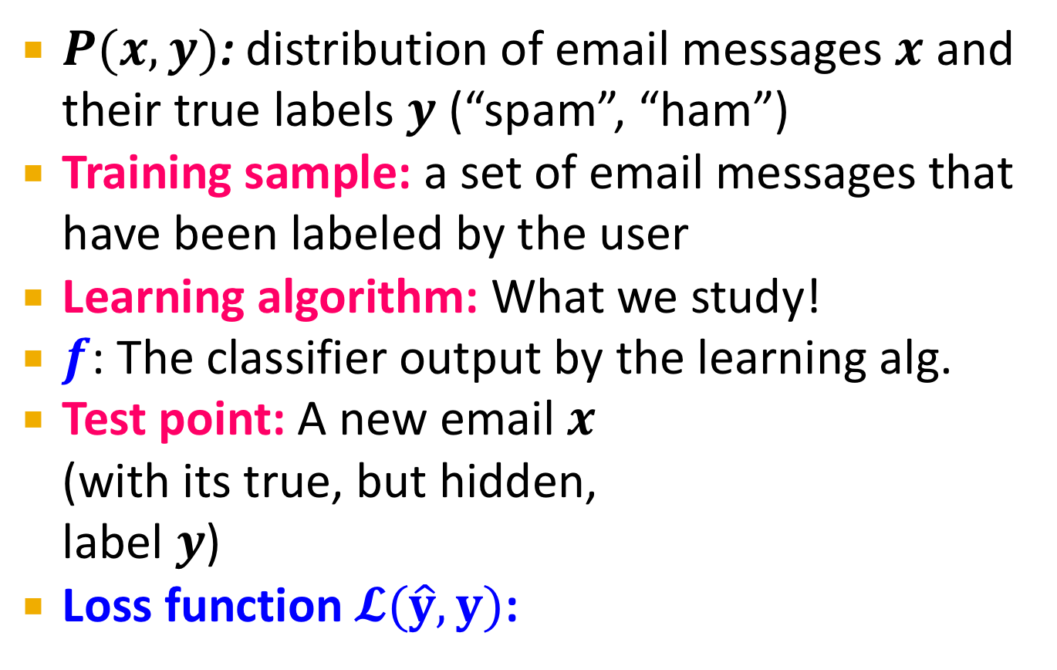
Spam Detection
$P(x,y)$: distribution of email messages $x$ and their true labels $y$ (“spam”, “ham”)
Training sample: a set of email messages that have been labeled by the user
Learning algorithm: What we study!
$f$: The classifier output by the learning alg.
Test point: A new email $x$ (with its true, but hidden, label $y$)
Loss function $𝓛(\hat{y},y)$:
predicted label $\hat{y}$ | true label $y$
 | spam | ham
spam | 0 | 10
not spam | 1 | 0

Slide 15
Large Scale Machine Learning
We will talk about the following methods:
Support Vector Machines
Decision trees
Main question: How to efficiently train (build a model/find model parameters)?

Slide 16
Support Vector Machines

Slide 17

Support Vector Machines
Want to separate “+” from “-” using a line
Data:
Training examples:
(x₁, y₁) … (x_{n}, y_{n})
Each example i:
x_{i} = ( x_{i}⁽¹⁾,… , x_{i}^{(d)} )
x_{i}^{(j)} is real valued
y_{i} ∈ { -1, +1 }
Inner product:
$w⋅x=\sum_{j=1}^{d}{w^{(j)} ⋅x^{(j)}}$
+
+
+
-
+
+
-
+
-
-
-
-
-
Which is best linear separator (defined by w,b)?

Slide 18
Largest Margin
Distance from the separating hyperplane corresponds to the “confidence” of prediction
Example:
We are more sure about the class of A and B than of C
A
C
+
+
+
+
-
+
B
-
+
+
-
+
-
-
+
-
-
-
-

Slide 19
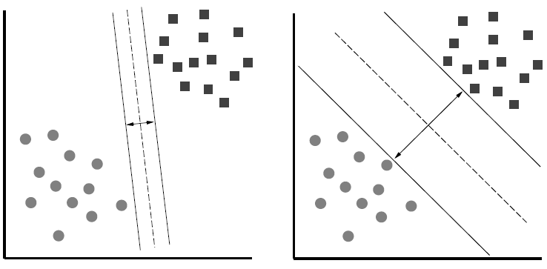
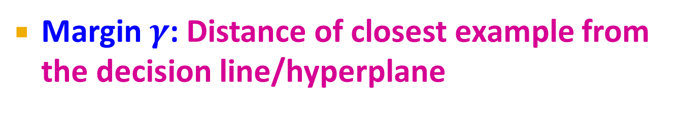
Largest Margin
Margin $γ$: Distance of closest example from the decision line/hyperplane
The reason we define margin this way is due to theoretical convenience and existence of generalization error bounds that depend on the value of margin.
Notes:
Why define margin as distance to the closest example, why not avg. or something else?
Purely theoretical

Slide 20
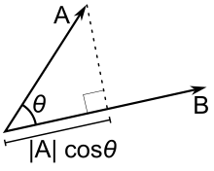



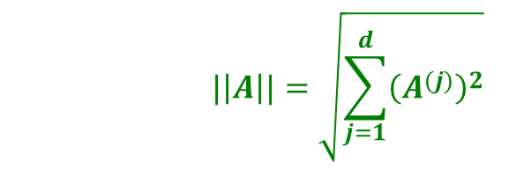
Why maximizing $γ$ a good idea?
Remember: The Dot product $A⋅B=\left\|A\right\|⋅\left\|B\right\|⋅\cos{θ}$
$$\left\|A\right\|cosθ$$
$$|\left|A\right||=\sqrt{\sum_{j=1}^{d}{{\left(A^{(j)}\right)}^{2}}}$$

Slide 21
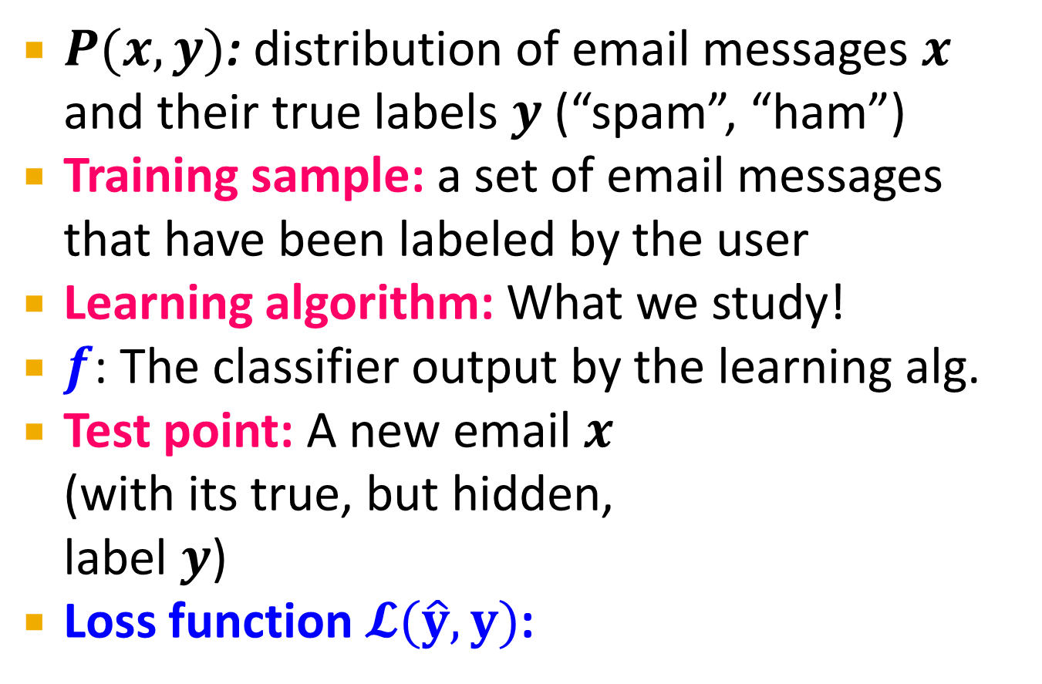

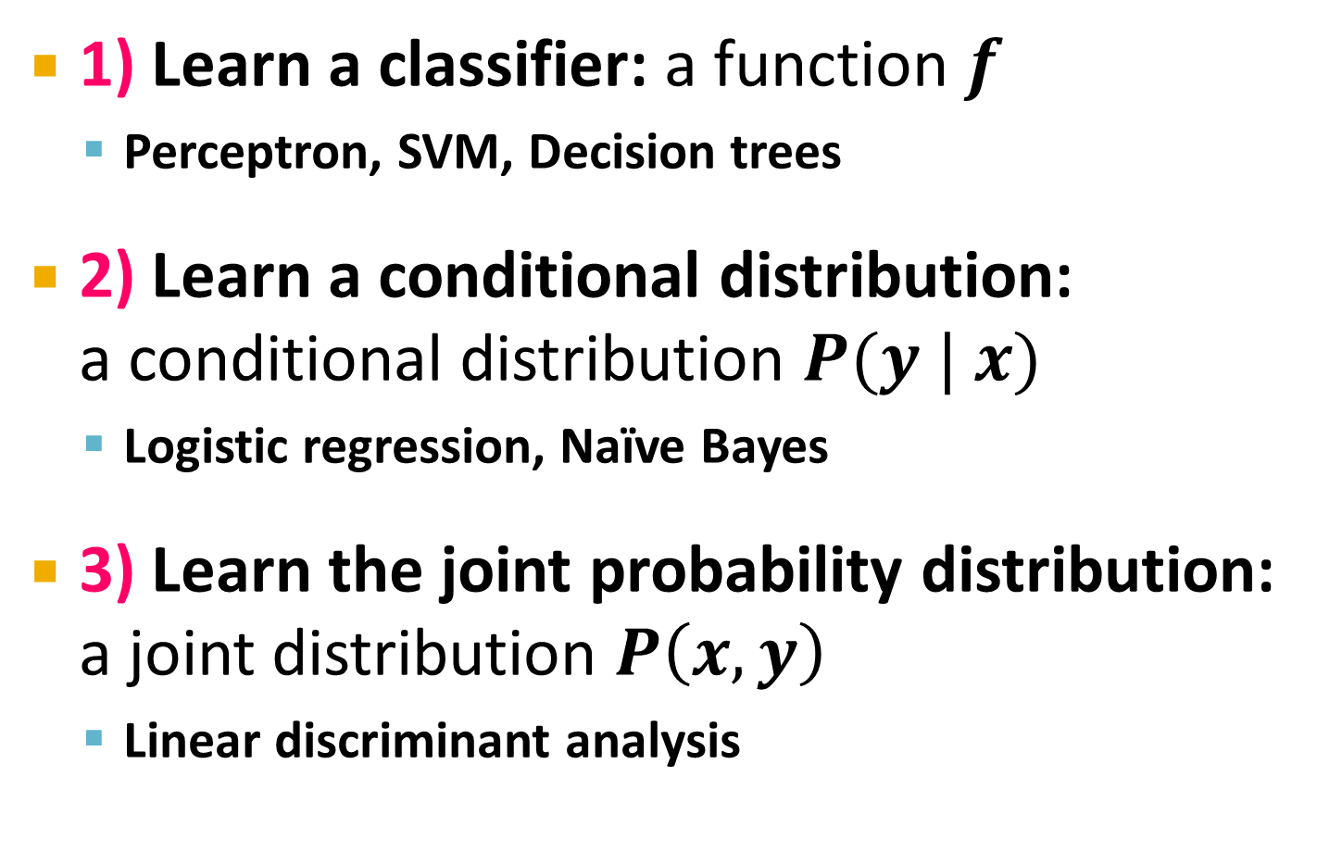

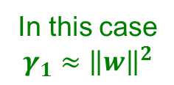

Why maximizing $γ$ a good idea?
Dot product $A⋅B=\left\|A\right\|\left\|B\right\|\cos{θ}$
What is $w⋅x_{1}$ , $w⋅x_{2}$?
So, $γ$ roughly corresponds to the margin
Bottom line: Bigger $γ$ bigger the separation
$$w$$
x₂
+
+
w ⋅ x + b = 0
x₁
x₂
x₂
+
+
+
+
x₁
x₁
$$w$$
$$w$$
In this case $$γ_{1}≈{\left\|w\right\|}^{2}$$
In this case
$$γ_{2}≈{2\left\|w\right\|}^{2}$$

Slide 22
What is the margin?
Distance from a point to a line
L
Note we assume ${\left\|w\right\|}_{2}=1$
Let:
Line L: w∙x+b = w⁽¹⁾x⁽¹⁾+w⁽²⁾x⁽²⁾+b=0
w = (w⁽¹⁾, w⁽²⁾)
Point A = (x_{A}⁽¹⁾, x_{A}⁽²⁾)
Point M on a line = (x_{M}⁽¹⁾, x_{M}⁽²⁾)
w
A (x_{A}⁽¹⁾, x_{A}⁽²⁾)
w ∙ x + b = 0
+
d(A, L)
H
d(A, L) = |AH|
= |(A-M) ∙ w|
= |(x_{A}⁽¹⁾ – x_{M}⁽¹⁾) w⁽¹⁾ + (x_{A}⁽²⁾ – x_{M}⁽²⁾) w⁽²⁾|
= |x_{A}⁽¹⁾ w⁽¹⁾ + x_{A}⁽²⁾ w⁽²⁾ + b|
= |w ∙ A + b|
(0,0)
M (x_{M}⁽¹⁾, x_{M}⁽²⁾)
Remember x_{M}⁽¹⁾w⁽¹⁾ + x_{M}⁽²⁾w⁽²⁾ = - b
since M belongs to line L

Slide 23
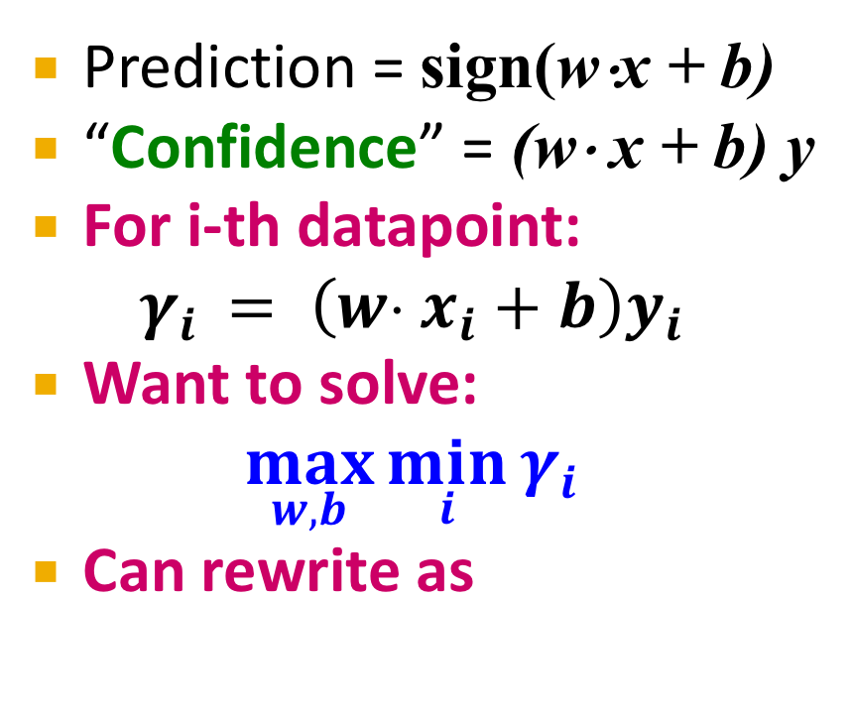

Largest Margin
Prediction = sign(w⋅x + b)
“Confidence” = (w⋅ x + b) y
For i-th datapoint: $γ_{i} = \left(w⋅ x_{i}+b\right)y_{i}$
Want to solve:
$$\max_{w,b}{\min_{i}{γ_{i}}}$$
Can rewrite as
$$w$$
+
+
+
+
w ⋅ x + b = 0
-
+
-
+
+
-
-
-
-
-

Slide 24

Support Vector Machine
Maximize the margin:
Good according to intuition, theory (c.f. “VC dimension”) and practice
$γ$ is margin … distance from the separating hyperplane
+
+
w⋅x+b=0
+
+
+
-
+
γ
+
γ
-
-
-
+
γ
-
-
-
Maximizing the margin

Slide 25
Support Vector Machines: Deriving the margin

Slide 26
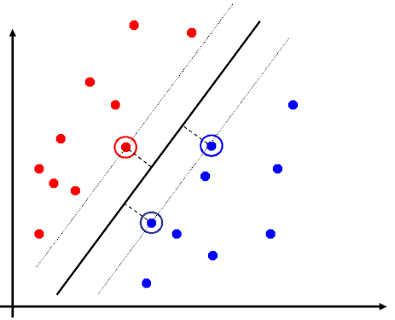
Support Vector Machines
Separating hyperplane is defined by the support vectors
Points on +/- planes from the solution
If you knew these points, you could ignore the rest
Generally, d+1 support vectors (for d dim. data)

Slide 27
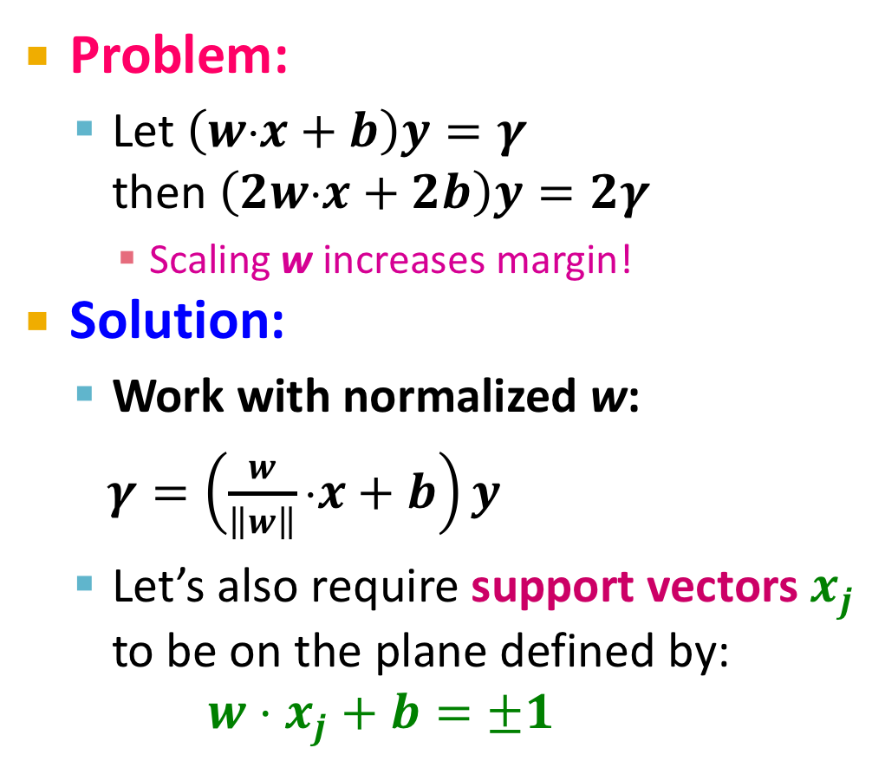
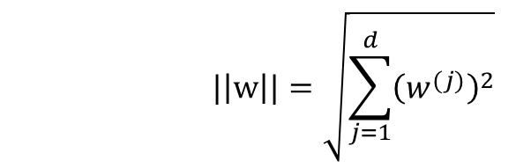
Canonical Hyperplane: Problem
Problem:
Let $\left(w⋅x+b\right)y=γ$ then $\left(2w⋅x+2b\right)y=2γ$
Scaling w increases margin!
Solution:
Work with normalized w:
$γ=\left(\frac{w}{\left\|w\right\|}⋅x+b\right)y$
Let’s also require support vectors $x_{j}$ to be on the plane defined by: $w⋅x_{j}+b=±1$
w⋅x+b=-1
w⋅x+b=0
w⋅x+b=+1
$$|\left|w\right||=\sqrt{\sum_{j=1}^{d}{{\left(w^{(j)}\right)}^{2}}}$$

Slide 28

Canonical Hyperplane: Solution
Want to maximize margin!
What is the relation between x₁ and x₂?
$x_{1}=x_{2}+2γ\frac{w}{||w||}$
We also know:
$w⋅x_{1}+b=+1$
$w⋅x_{2}+b=−1$
So:
$w⋅x_{1}+b=+1$
$w\left(x_{2}+2γ\frac{w}{||w||}\right)+b=+1$
$w⋅x_{2}+b+2γ\frac{w⋅w}{\left|\left|w\right|\right|}=+1$
w⋅x+b=-1
w⋅x+b=0
w⋅x+b=+1
2γ
Note:
-1

Slide 29
Maximizing the Margin
We started with
But w can be arbitrarily large!
We normalized and...
Then:
w⋅x+b=-1
w⋅x+b=0
w⋅x+b=+1
2γ
This is called SVM with “hard” constraints

Slide 30
Non-linearly Separable Data
If data is not separable introduce penalty:
Minimize ǁwǁ² plus the number of training mistakes
Set C using cross validation
How to penalize mistakes?
All mistakes are not equally bad!
+
+
w⋅x+b=0
+
-
+
+
-
+
-
-
+
-
+
-
-
-
-

Slide 31
Support Vector Machines
Introduce slack variables ξ_{i}
If point x_{i} is on the wrong side of the margin then get penalty ξ_{i}
+
w⋅x+b=0
+
+
-
+
ξ_{i}
+
+
ξ_{j}
-
-
+
+
-
-
-
For each data point:
If margin ≥ 1, don’t care
If margin < 1, pay linear penalty
Notes:
ksi

Slide 32

Slack Penalty $C$
What is the role of slack penalty C:
C=∞: Only want to w, b that separate the data
C=0: Can set ξ_{i} to anything, then w=0 (basically ignores the data)
small C
+
“good” C
+
+
+
+
big C
+
-
-
+
+
-
-
-
-
(0,0)

Slide 33
Support Vector Machines
SVM in the “natural” form
SVM uses “Hinge Loss”:
Margin
Empirical loss L (how well we fit training data)
Regularization parameter
penalty
0/1 loss
Hinge loss: max{0, 1-z}
-1 0 1 2

Slide 34
Support Vector Machines: How to compute the margin?

Slide 35
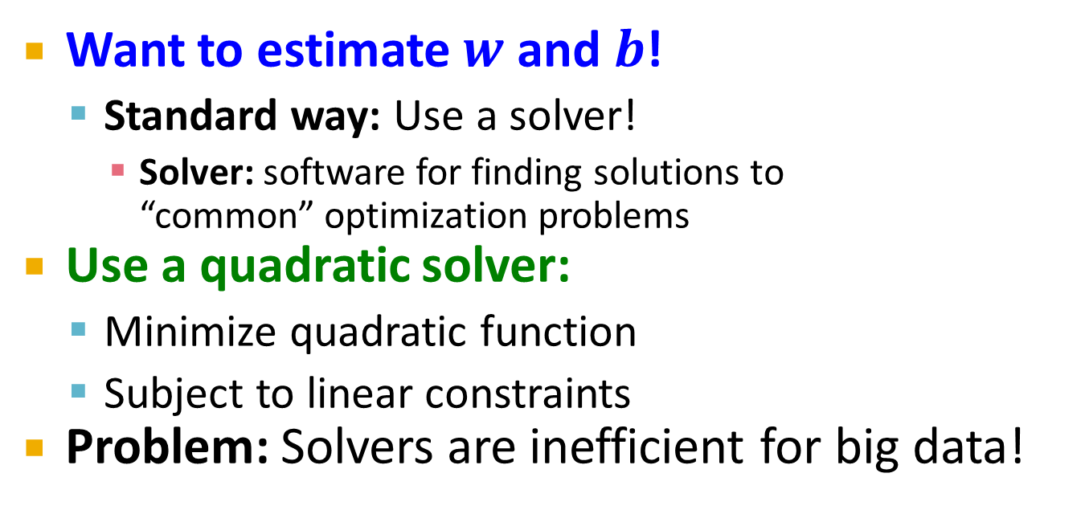
SVM: How to estimate w?
Want to estimate $w$ and $b$!
Standard way: Use a solver!
Solver: software for finding solutions to “common” optimization problems
Use a quadratic solver:
Minimize quadratic function
Subject to linear constraints
Problem: Solvers are inefficient for big data!

Slide 36

SVM: How to estimate w?
Want to minimize J(w,b):
Compute the gradient ∇(j) w.r.t. w^{(j)}
Empirical loss $L(x_{i} y_{i})$

Slide 37
SVM: How to estimate w?
Gradient descent:
Problem:
Computing ∇J^{(j)} takes O(n) time!
n … size of the training dataset
Iterate until convergence:
For j = 1 … d
Evaluate:
Update: w’^{(j)} ← w^{(j)} - η∇J^{(j)}
w ← w’
η…learning rate parameter C… regularization parameter

Slide 38
SVM: How to estimate w?
We just had:
Stochastic Gradient Descent
Instead of evaluating gradient over all examples evaluate it for each individual training example
Stochastic gradient descent:
Notice: no summation over i anymore
Iterate until convergence:
For i = 1 … n
For j = 1 … d
Compute: ∇J^{(j)}(x_{i})
Update: w^{(j)} ← w^{(j)} - η ∇J^{(j)}(x_{i})

Slide 39
Support Vector Machines: Example

Slide 40
Example: Text categorization
Example by Leon Bottou:
Reuters RCV1 document corpus
Predict a category of a document
One vs. the rest classification
n = 781,000 training examples (documents)
23,000 test examples
d = 50,000 features
One feature per word
Remove stop-words
Remove low frequency words

Slide 41
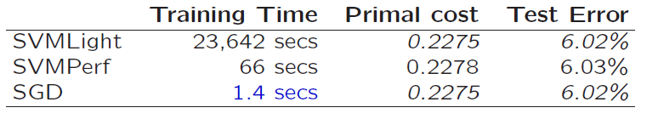
Example: Text categorization
Questions:
(1) Is SGD successful at minimizing J(w,b)?
(2) How quickly does SGD find the min of J(w,b)?
(3) What is the error on a test set?
Training time Value of J(w,b) Test error
Standard SVM “Fast SVM”
SGD-SVM
(1) SGD-SVM is successful at minimizing the value of J(w,b)
(2) SGD-SVM is super fast
(3) SGD-SVM test set error is comparable

Slide 42
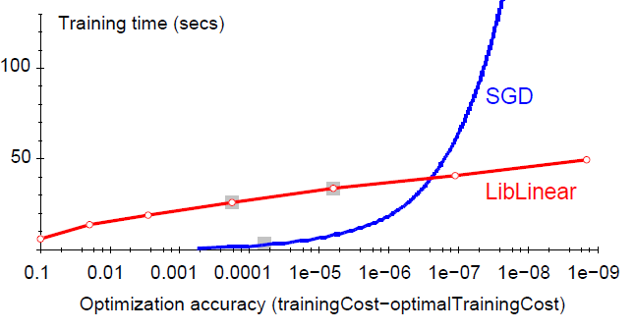
Optimization “Accuracy”
SGD SVM
Conventional SVM
Optimization quality: | J(w,b) – J (w^{opt},b^{opt}) |
For optimizing J(w,b) within reasonable quality SGD-SVM is super fast

Slide 43
Practical Considerations
Need to choose learning rate η and t₀
Leon suggests:
Choose t₀ so that the expected initial updates are comparable with the expected size of the weights
Choose η:
Select a small subsample
Try various rates η (e.g., 10, 1, 0.1, 0.01, …)
Pick the one that most reduces the cost
Use η for next 100k iterations on the full dataset

Slide 44
Practical Considerations
Sparse Linear SVM:
Feature vector x_{i} is sparse (contains many zeros)
Do not do: x_{i} = [0,0,0,1,0,0,0,0,5,0,0,0,0,0,0,…]
But represent x_{i} as a sparse vector x_{i}=[(4,1), (9,5), …]
Can we do the SGD update more efficiently?
Approximated in 2 steps:
cheap: x_{i} is sparse and so few coordinates j of w will be updated
expensive: w is not sparse, all coordinates need to be updated
Notes:
The two-step update is not equivalent!
Why does it work?
Since eta is close to 0 you can do this. You get one more eta^2 term that is low order

Slide 45
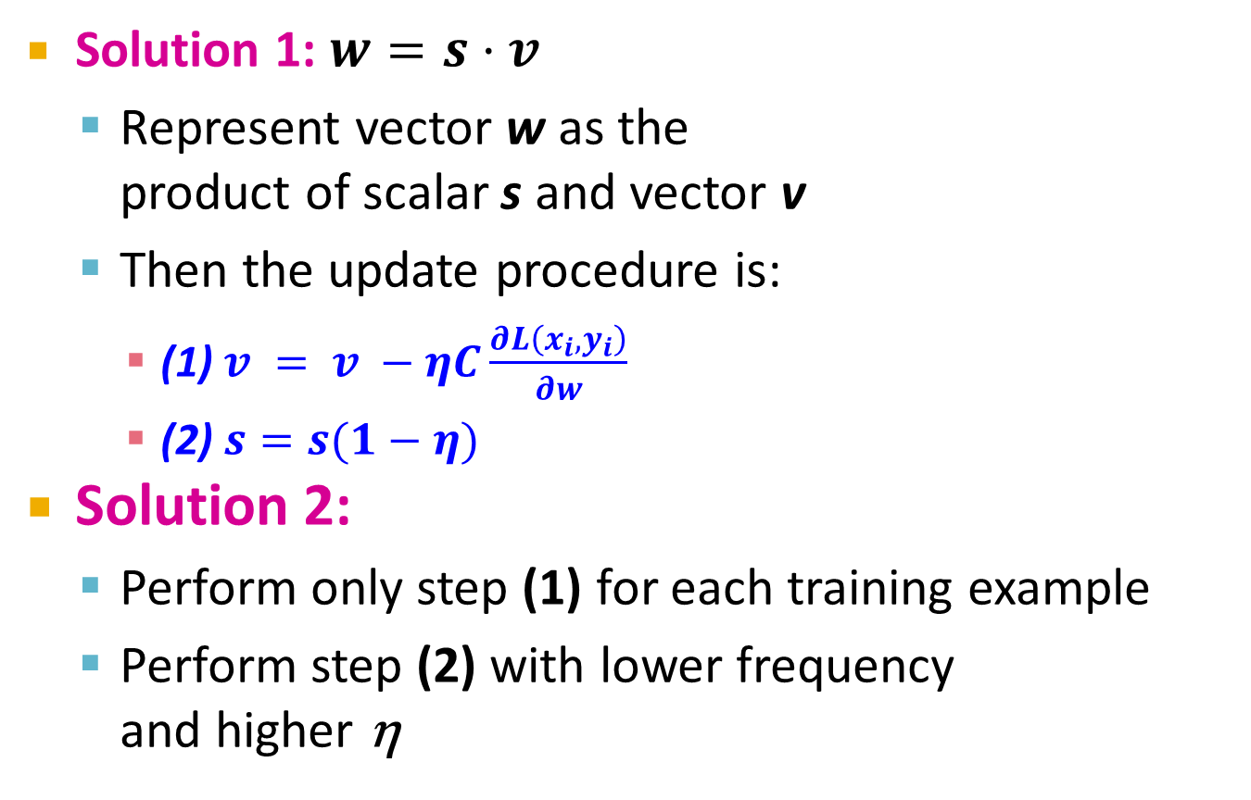
Practical Considerations
Solution 1: $w=s⋅v$
Represent vector w as the product of scalar s and vector v
Then the update procedure is:
(1) $v = v −ηC\frac{∂L\left(x_{i},y_{i}\right)}{∂w}$
(2) $s=s(1−η)$
Solution 2:
Perform only step (1) for each training example
Perform step (2) with lower frequency and higher η
Two step update procedure:
(1)
(2)

Slide 46
Practical Considerations
Stopping criteria:
How many iterations of SGD?
Early stopping with cross validation
Create a validation set
Monitor cost function on the validation set
Stop when loss stops decreasing
Early stopping
Extract two (very) small sets of training data A and B
Train on A, stop by validating on B
Number of training epochs on A is an estimate of k
Train for k epochs on the full dataset

Slide 47
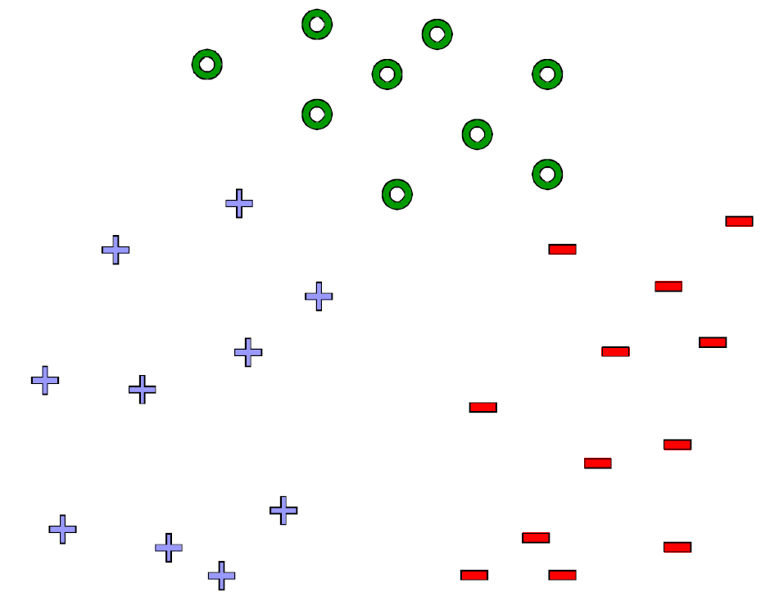
What about multiple classes?
Idea 1: One against all Learn 3 classifiers
+ vs. {o, -}
- vs. {o, +}
o vs. {+, -}
Obtain:
w₊ b₊, w₋ b₋, w_{o} b_{o}
How to classify?
Return class c arg max_{c} w_{c} x + b_{c}

Slide 48
Learn 1 classifier: Multiclass SVM
Idea 2: Learn 3 sets of weights simoultaneously!
For each class c estimate w_{c}, b_{c}
Want the correct class y_{i} to have highest margin:
w_{yi} x_{i} + b_{yi} ≥ 1 + w_{c} x_{i} + b_{c} ∀c ≠ y_{i} , ∀i
(x_{i}, y_{i})

Slide 49
Multiclass SVM
Optimization problem:
To obtain parameters w_{c} , b_{c} (for each class c) we can use similar techniques as for 2 class SVM
SVM is widely perceived a very powerful learning algorithm

Slide 50
Support Vector Machines: Example

Slide 51
Online Learning
New setting: Online Learning
Allows for modeling problems where we have a continuous stream of data
We want an algorithm to learn from it and slowly adapt to the changes in data
Idea: Do slow updates to the model
SGD-SVM makes updates if misclassifying a datapoint
So: First train the classifier on training data. Then for every example from the stream, if we misclassify, update the model (using a small learning rate)

Slide 52
Example: Shipping Service
Protocol:
User comes and tell us origin and destination
We offer to ship the package for some money ($10 - $50)
Based on the price we offer, sometimes the user uses our service (y = 1), sometimes they don't (y = -1)
Task: Build an algorithm to optimize what price we offer to the users
Features x capture:
Information about user
Origin and destination
Problem: Will user accept the price?

Slide 53
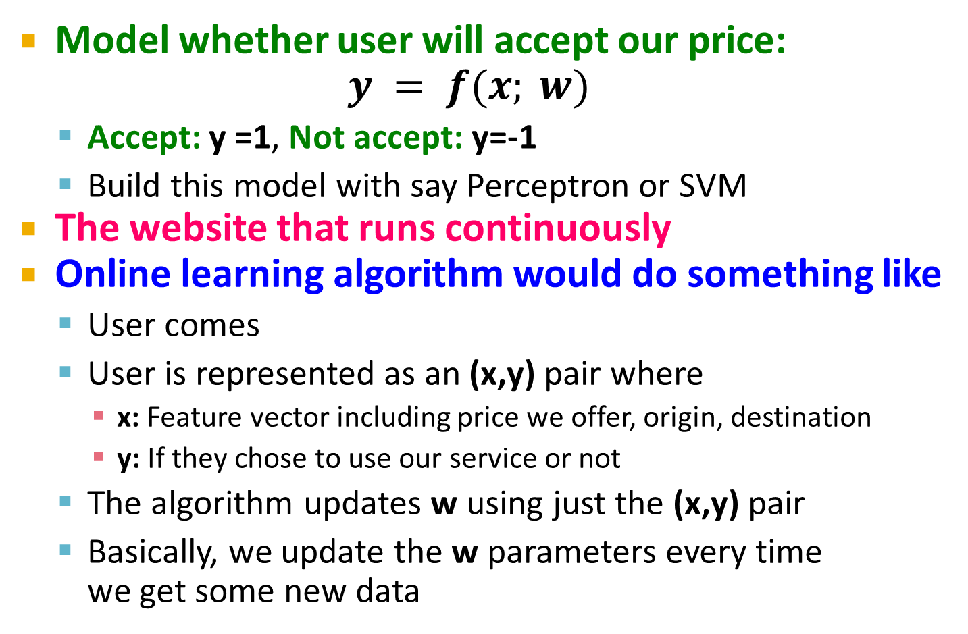
Example: Shipping Service
Model whether user will accept our price: $y = f(x; w)$
Accept: y =1, Not accept: y=-1
Build this model with say Perceptron or SVM
The website that runs continuously
Online learning algorithm would do something like
User comes
User is represented as an (x,y) pair where
x: Feature vector including price we offer, origin, destination
y: If they chose to use our service or not
The algorithm updates w using just the (x,y) pair
Basically, we update the w parameters every time we get some new data

Slide 54
Example: Shipping Service
We discard this idea of a data “set”
Instead we have a continuous stream of data
Further comments:
For a major website where you have a massive stream of data then this kind of algorithm is pretty reasonable
Don’t need to deal with all the training data
If you had a small number of users you could save their data and then run a normal algorithm on the full dataset
Doing multiple passes over the data

Slide 55
Online Algorithms
An online algorithm can adapt to changing user preferences
For example, over time users may become more price sensitive
The algorithm adapts and learns this
So the system is dynamic

